Slide 1
Dobrodošli
BCS 201 FALL 2023
Tamara Pavlović
Made by Tamara Pavlović for FALL 2023, 20/8/2023

Slide 2
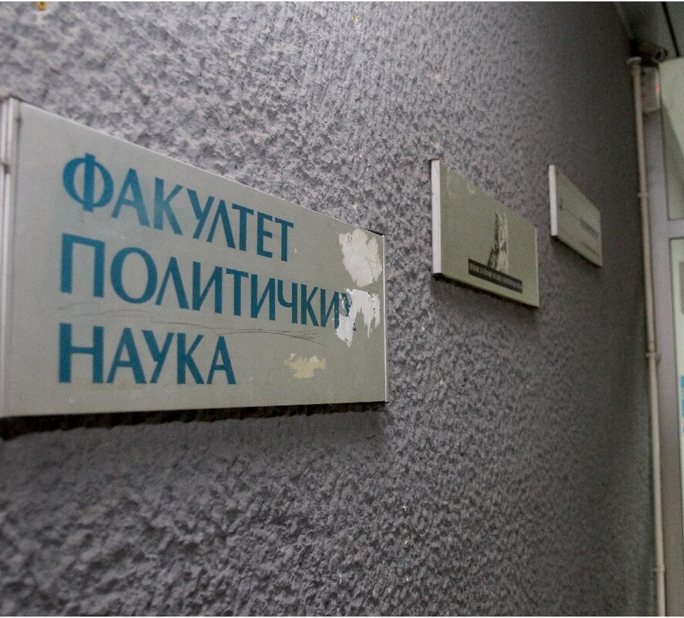
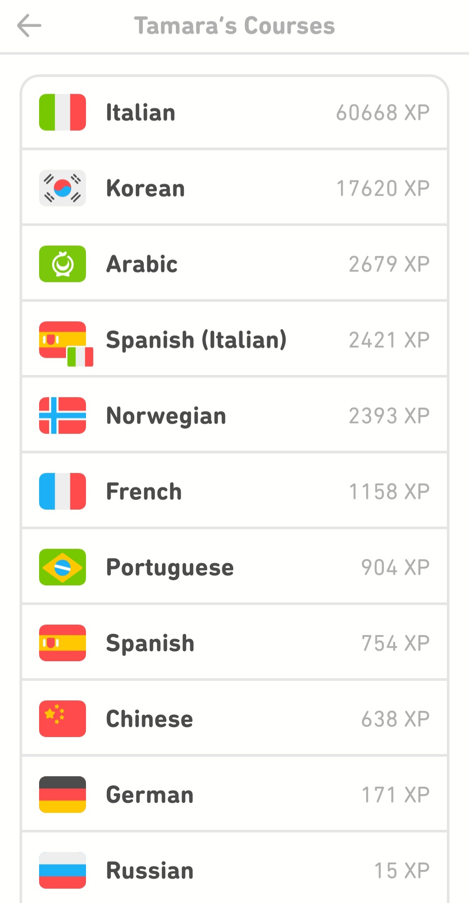
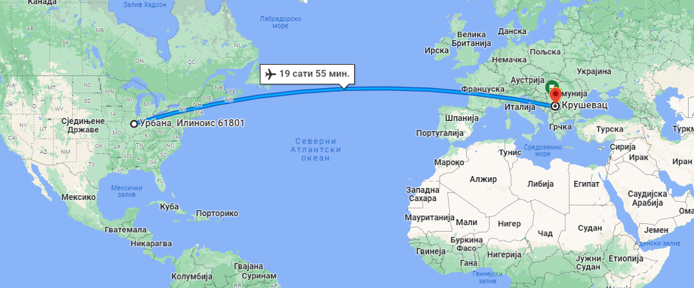
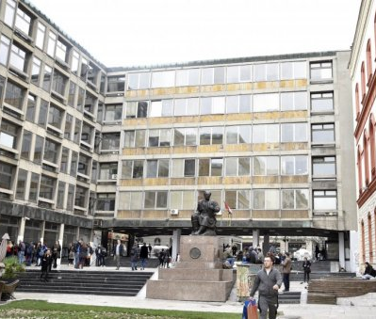
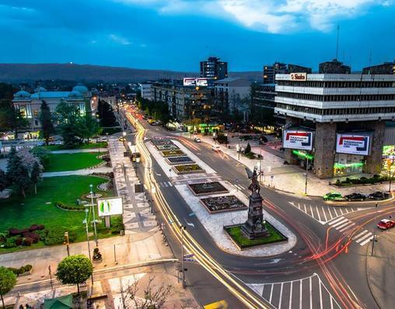
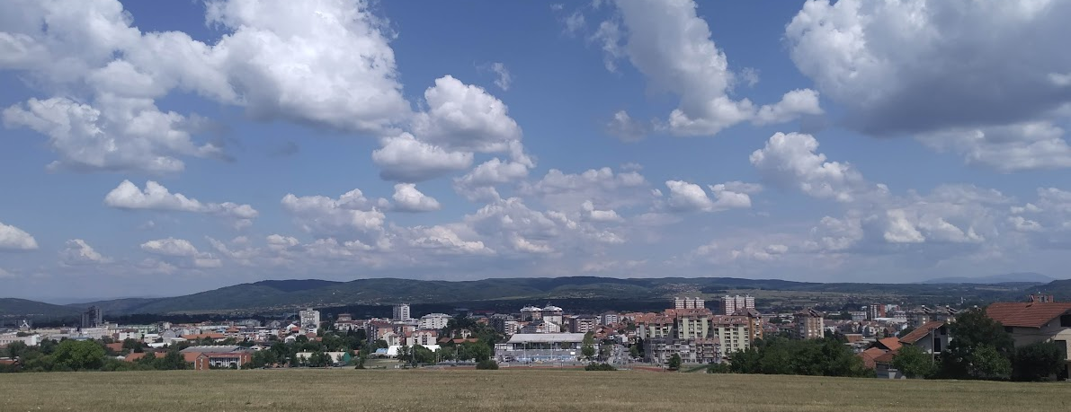

Slide 3
Introductions
Name, major, year, hobbies
What brought you to BCS 201?
What is the most boring fact about you?

Slide 4
Course Overview
MTWT 10:00-10:50 AM
Room 1030 LCL
Instructor: Tamara Pavlović
Email: tamara6@illinois.edu
Office hours:
Option 1: Thursdays and Wednesdays from 11 AM to 12 PM at the office 3165 Literature, Cultures, and Linguistics Building, or via Zoom (Email instructor at least 5 minutes before the office hours begin if you are joining over Zoom)
Option 2: By appointment, in person, or over Zoom.
*Zoom link in the syllabus

Slide 5

Course Objectives
Students will be able to hold conversations in BCS in a range of contexts with native speakers of BCS
Students will be able to hold conversations in BCS in a range of contexts with native speakers of BCS
Students will be able to hold conversations in BCS in a range of contexts with native speakers of BCS

Slide 6
General Overview
Use of the BCS in class
Required textbook:
Introduction to the Croatian and Serbian Language, Revised Edition, Thomas F. Manger
(University Park: Pennsylvania State Press, 2003), ISBN: 0-271-01536-5
Platforms:
  Moodle
  Padlet
  Additional platforms may be added

Slide 7
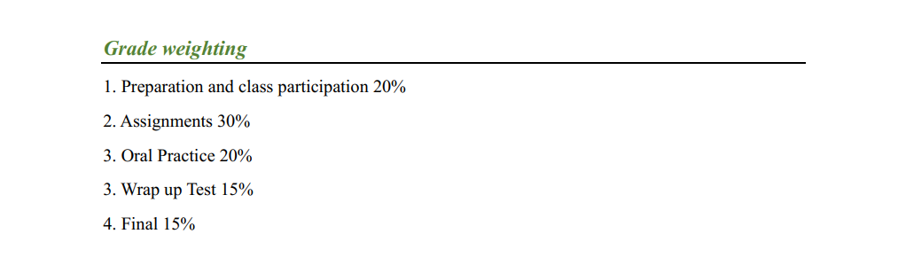
Grades

Slide 8
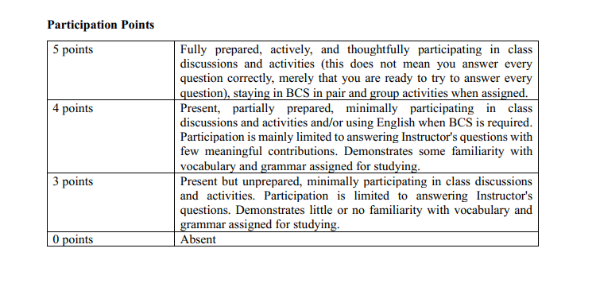
Grades- Participation 15%
Preparation: Your participation will be evaluated based on your preparation, the degree of your enthusiastic participation, and the accuracy and fluency in the performance of classroom activities.
Attendance: Students with 8 or more absences (total) will not receive a passing grade. Make sure to be on time for class. Showing up 5 minutes after the class begins is considered late arrival. Two instances of a late arrival will count as one absence. In the case of illness, religious holidays, family emergencies, or university obligations, please notify your Instructor in advance and provide a written note when appropriate.

Slide 9
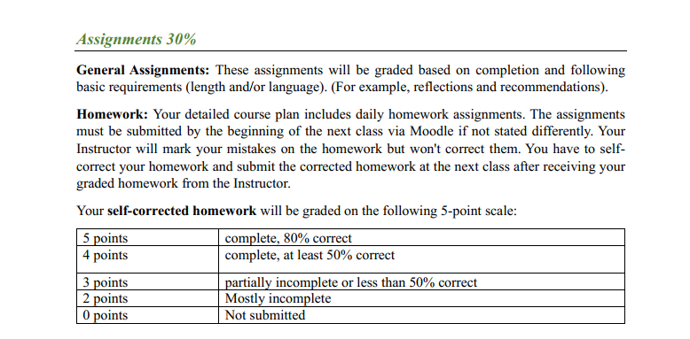
Grades- Assignments 30%

Slide 10
Grades- Oral Practice 20%
Oral practice will include interpersonal tasks (short conversations) during class and presentational tasks that will be uploaded through Flipgrid.
Instructions for each oral practice will be given promptly. The lowest
grade of completed oral practice will be dropped from the final course grade.
For the rubric refer to Syllabus.

Slide 11
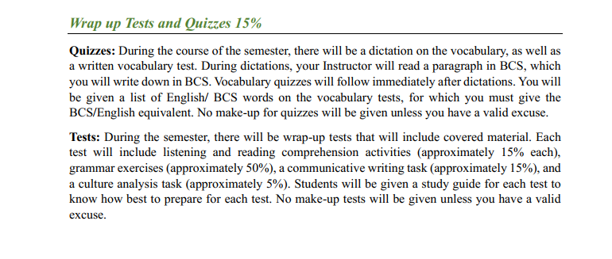
Grades- Wrap Up Tests 15%

Slide 12
Grades- Final Exam 15%

Slide 13
Additional Infromation in Syllabus
Letter grades
Academic Integrity
Late Assignments
Accommodations

Slide 14
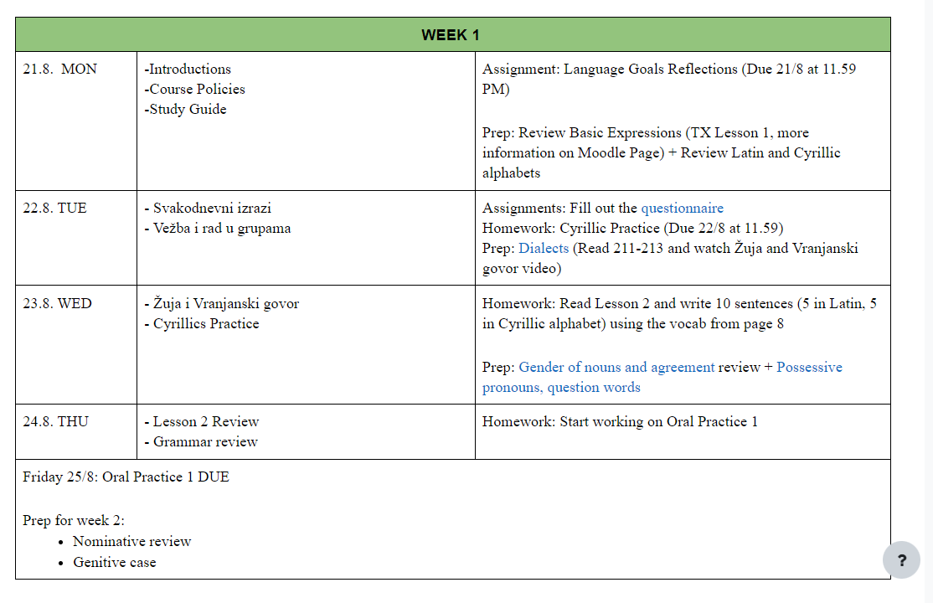
Daily Plan

Slide 15
Preparation for class on Tuesday
Language Goals Reflection Due Monday 21/8/23
Review Basic Expressions (TX Lesson 1, more information on Moodle Page) + Review Latin and Cyrillic alphabets

Slide 16
Srećno!

